Slide 1


BVH

Slide 2
BVH
Robot Media Laboratory
BVH file - Biovision Hierarchical motion capture data (.bvh)
A .bvh file is nothing more than a text file that has data that was captured from a moving skeletal system. Another name for this type of data capture is "Motion Capture" which has been abbreviated as mocap. A .bvh file can be made by software or by hardware. Most studio houses that do their own commercial animation have their own type of motion capture technique.
The .bvh files that I will be using were obtained from a company that uses a type of Optical Motion Capture to make their files. I also use some .bvh files made from a software program called Poser http://www.curiouslabs.com/ Poser is really easy to use and you can setup your own animations in minutes. You can then export as a .bvh file and bring them right into Blender. Below is a section of a sample .bvh file. The file has basically two main parts.
1. The hierachy breakdown of the skeletal system used →골격시스템의 계층 구조
2. the actual coordinates of the individual movements.) →개별 동작의 실제 좌표
요약 :
1. BVH는 단순히 moving skeletal system으로부터 캡쳐된 데이터 정보를 담고 있는
텍스트 파일이다.
2. Poser라는 프로그램으로 쉽게 만들어질 수 있다. 또한 Blender 프로그램으로 확인 가능하다.

Slide 3
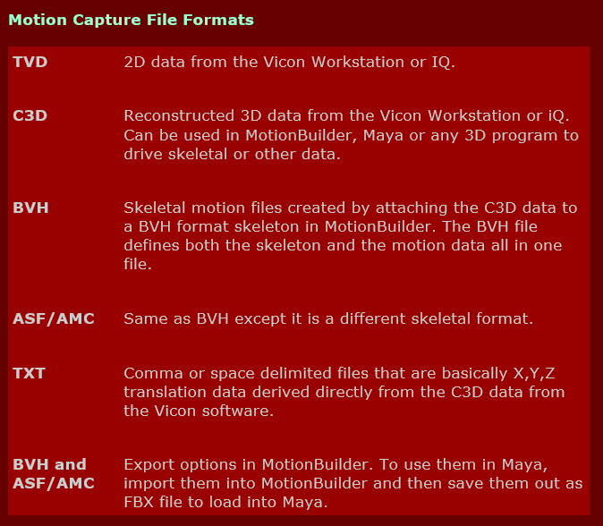
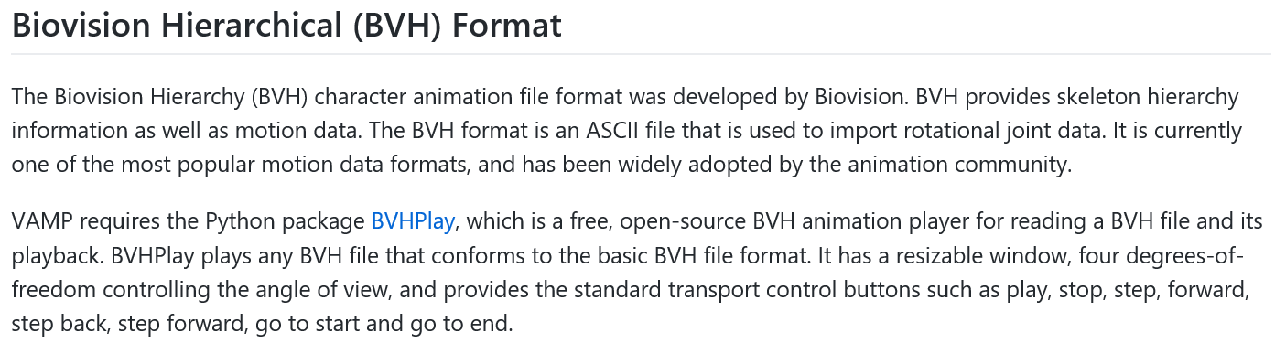
BVH파일외의 다른 Motion data
Robot Media Laboratory
Position data
Rotation data
(오일러 각 형태로 표시된 (Z,X,Y) skeleton)
표준

Slide 4
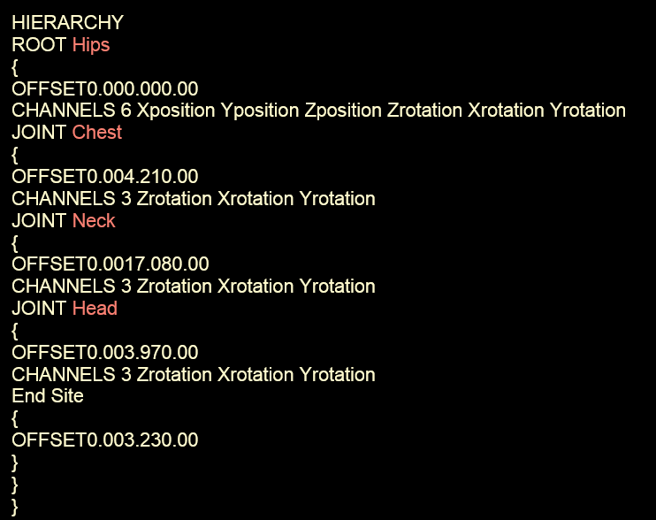
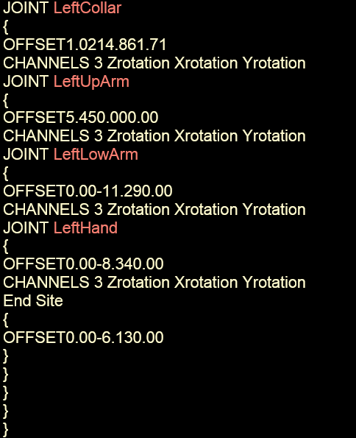
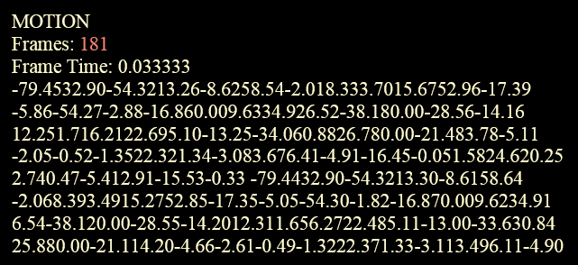
BVH파일의 구조
Robot Media Laboratory
Part1, 골격시스템의 계층 구조
Part2, 개별 동작의 실제 좌표

Slide 5
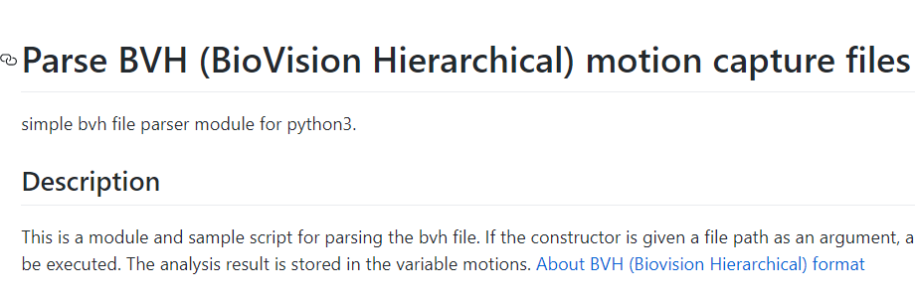
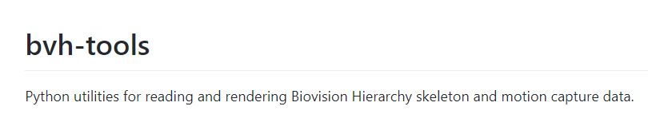
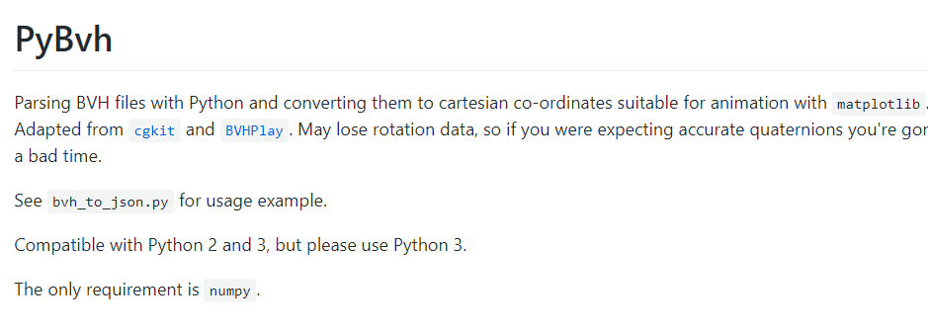
Motion Prediction
Robot Media Laboratory

Slide 6
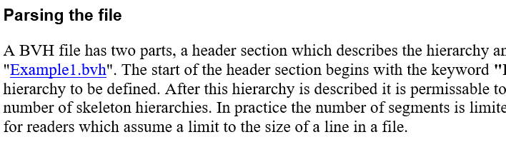
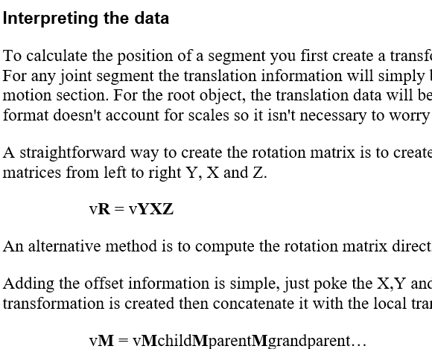
Motion Prediction
http://research.cs.wisc.edu/graphics/Courses/cs-838-1999/Jeff/BVH.html
Robot Media Laboratory

Slide 7
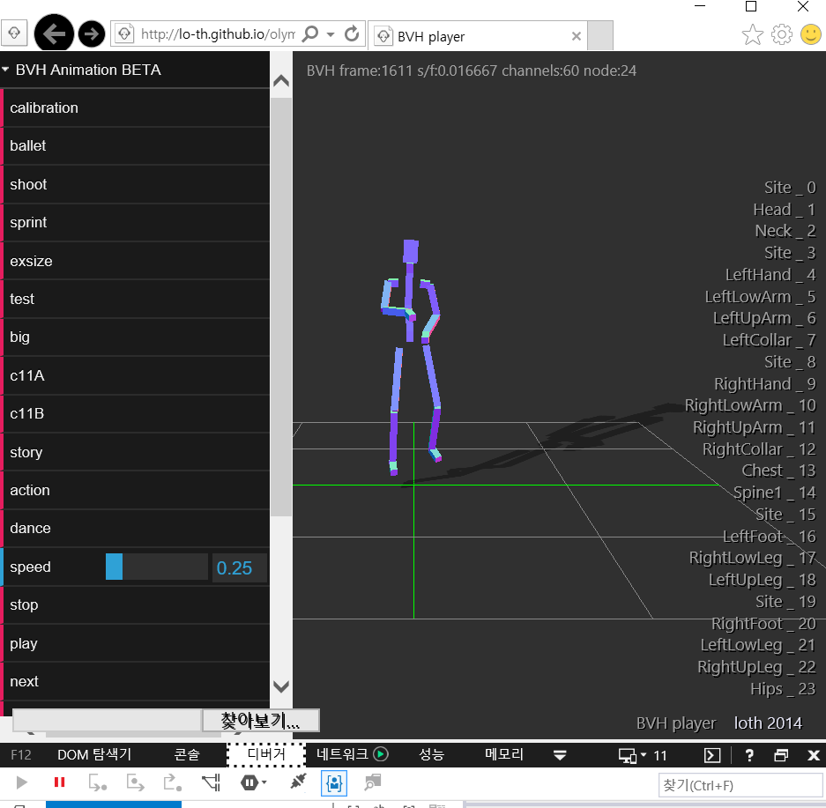
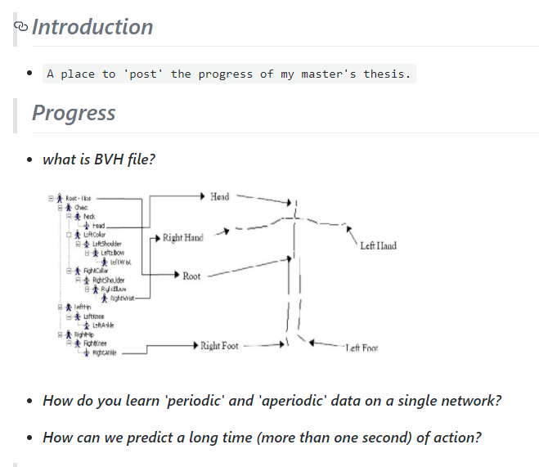
Motion Prediction
Robot Media Laboratory
bvh.html
http://lo-th.github.io/olympe/BVH_player.html
On Human Motion Prediction Using Recurrent Neural Networks(2017 CVPR에서 발표예정)

Slide 8
감사합니다.

